Slide 1
Is the U.S. in an Economic Decline?
New Canaan Senior Men Club – January 29, 2016
Paul A. Strassmann

Slide 2
Presentation Outline
Assessment of the Current Situation
How to View the Stock Market
Personal Prospects for Seniors
How to Preserve Savings

Slide 3
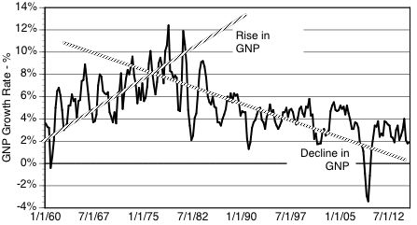
Underlying Cause of Decline: Gross National Product Trend
http://www.gurufocus.com/economic_indicators/58/sp-500-earnings

Slide 4
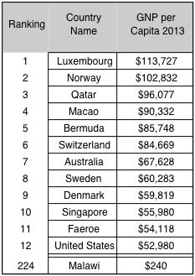
U.S. Is Still Prosperous: GNP/Capita Ranks #12 Of 224 Countries
http://databank.worldbank.org/data/reports.aspx?source=world-development-indicators&preview=on&l=en#

Slide 5
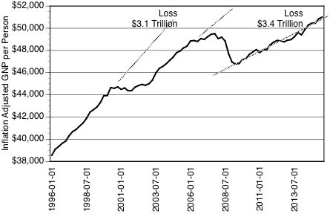
U.S. Stumble: Loss of Personal Income During Recent Recessions
https://research.stlouisfed.org/fred2/series/A939RX0Q048SBEA#

Slide 6
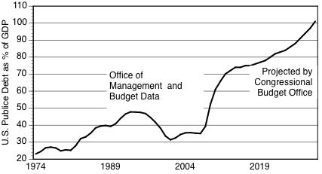
Outlook not Promising: Public Debt Projected to Exceed the GDP
http://www.concordcoalition.org/issues/indicators/us-debt-unsustainable-

Slide 7
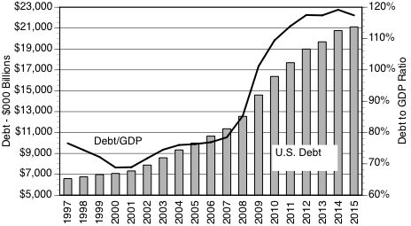
Major Hurdle: Debt More Than Doubled by $14 Trillion

Slide 8
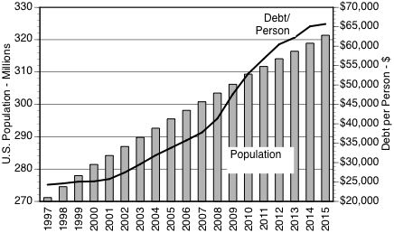
Adverse Indicator: Debt/Person Increased Faster Than Population
http://www.usgovernmentdebt.us/spending_chart_1997_2017USb_17s2li111mcn_H0t#copypaste

Slide 9
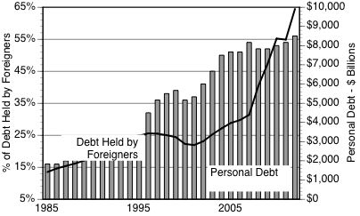
Is That a Threat? - Foreigners Hold 65% of Personal Debt
http://www.concordcoalition.org/issues/indicators/national-debt-increasingly-owned-foreigners

Slide 10
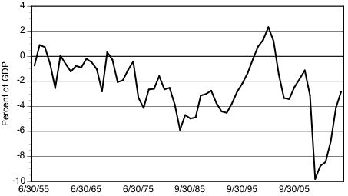
Bad News: Federal Government Deficit Continues to Increase

Slide 11
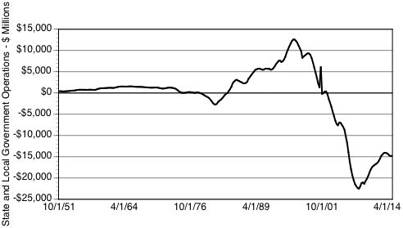
Bad News: Deficits of State and Local Government Increasing

Slide 12
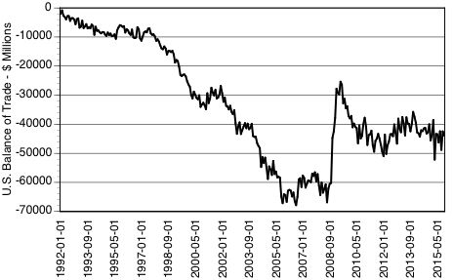
Unfavorable Trend: Negative Balance of U.S. Trade Since 1992

Slide 13
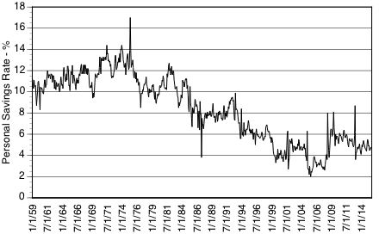
Unfavorable Trend: Personal Savings Rates Have Declined

Slide 14
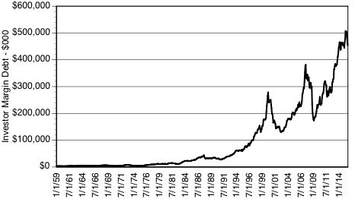
An Unfavorable Indicator: Brokerage Debt is Increasing
http://www.gurufocus.com/economic_indicators/25/personal-saving-rate

Slide 15
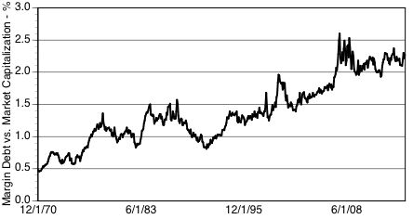
Bad Sign: Investor Margin Debt Now Exceeds Market Capitalization

Slide 16
The Stock Market

Slide 17
Unfavirable Indicator: S&P 500 Becomes Unstable After 2000
: http://www.econ.yale.edu/~shiller/data.htm

Slide 18
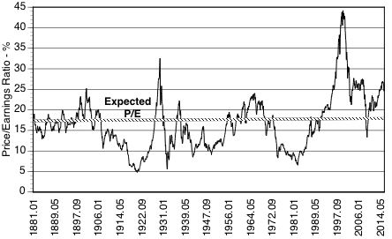
Stock Market Overvalued According to Yale Dept. of Economics
http://www.econ.yale.edu/~shiller/data.htm

Slide 19
Confirmation of Adverse Trend: S&P Earnings Yields Have Declined
http://www.multpl.com/s-p-500-earnings-yield/table/by-month

Slide 20
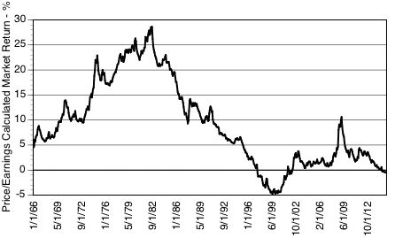
A Warning: Stock Market Returns Have Declined Close to Zero

Slide 21
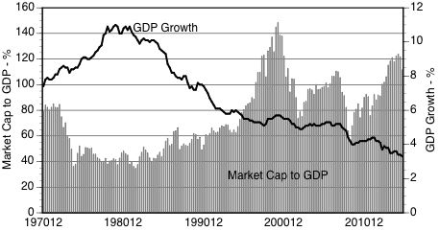
Bad Signal: Market Cap to GDP Growth Now Exceeds GDP Growth

Slide 22
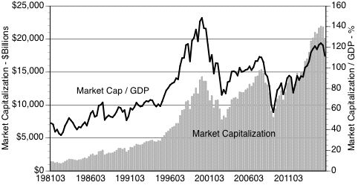
Bad Signal: Market Cap/GDP is Now Greater Than 100%

Slide 23
Personal Prospects

Slide 24
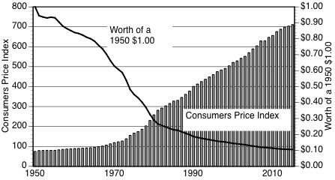
Unfavorable Trend: Decline in the Value of a Dollar
http://data.bls.gov/pdq/SurveyOutputServlet

Slide 25
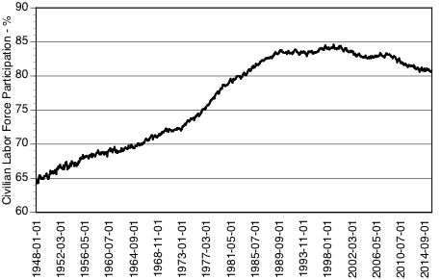
Unfavorable Trend: Labor Force Stopped Growing

Slide 26
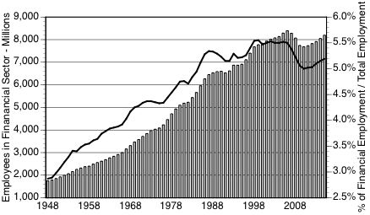
Of Interest to NC: Employment in Financial Sector Keeps Declining

Slide 27
Unfavorable Trend: Long Term Unemployment is Rising
http://www.dol.gov/

Slide 28
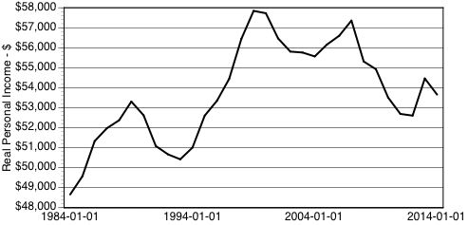
Unfavorable Trend: U.S. Real Median Income Declined Since 1990
https://research.stlouisfed.org/fred2/series/MEHOINUSA672N#

Slide 29
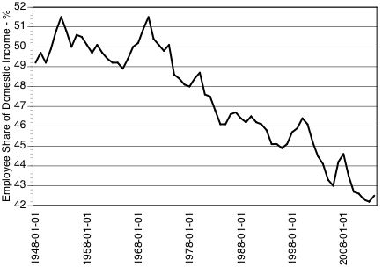
Employee Share of Domestic Income Has Declined Since 1968
https://research.stlouisfed.org/fred2/series/W270RE1A156NBEA#

Slide 30
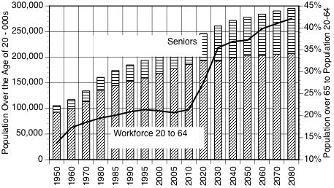
U.S. Seniors Will Require a Larger Support Population

Slide 31
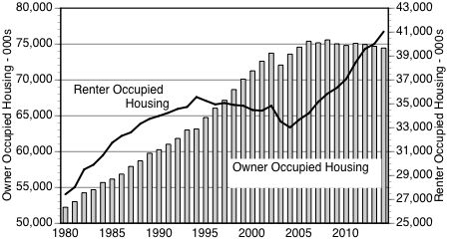
Occupancy of Housing is Shifting from Ownership to Rentals

Slide 32
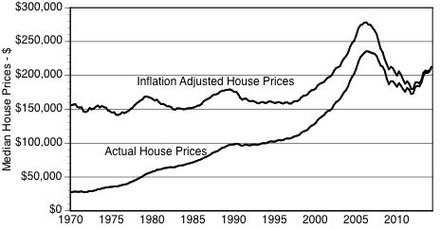
Price of Homes Have Not Changed Since 2006
SOURCE: http://www.jparsons.net/housingbubble/

Slide 33
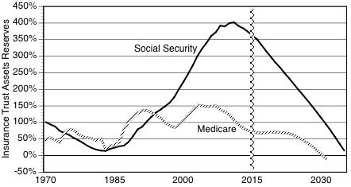
Social Security Trust Fund Declines

Slide 34
How to Preserve Savings

Slide 35
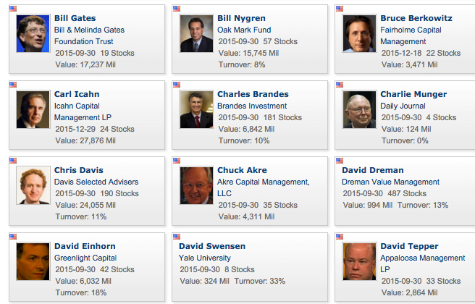
Option: Follow What Leading Investors Do
http://www.gurufocus.com/Invest_guide_guru.php

Slide 36
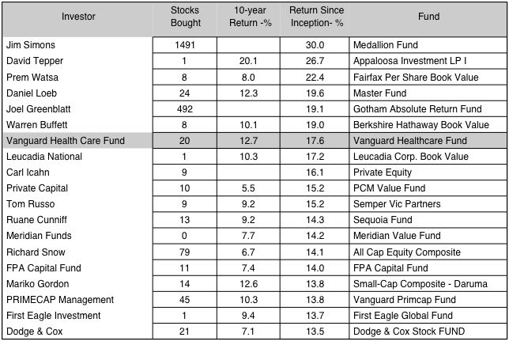
Follow Performance of Leading Investors
http://www.gurufocus.com/Invest_guide_guru.php

Slide 37
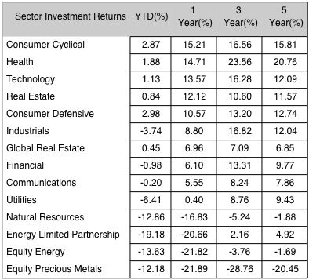
Opportunities: Select High Performance Funds

Slide 38
Pick High Potential Opportunities

Slide 39
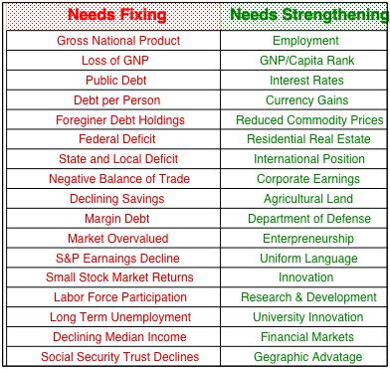
Scoreboard

Slide 40
Is the U.S. in an Economic Decline?
U.S. Still the Greatest Economy
But U.S. Is Slipping – Needs Fixing

Slide 41
SMC Investment Recommendations
Rule # 1: Avoid Losses
Rule # 2: Get Incremental Gains

